Slide 1


APPLIED MACHINE LEARNING FOR TEXT ANALYTICS (24ALT3101)
REVIEW – 1
Retrieval-Augmented Generation Chatbot for University Academic Assistance
Team No-17
2420030657-K.Akshitha Reddy
2420030735-G.V.S Hasini
2420030703-G.Hemalatha
Department of Computer Science and Engineering
KONERU LAKSHMAIAH EDUCATION FOUNDATION

Slide 2
OUTLINE
Introduction
Objectives
Literature Survey
Proposed Method
Conclusion

Slide 3
Introduction
Universities provide a large amount of academic information such as syllabi, course details, examination schedules, academic regulations, notices, and attendance rules. However, students often find it difficult and time-consuming to search through different websites, portals, and documents to find the exact information they need. To solve this problem, our project proposes a Retrieval-Augmented Generation (RAG) Chatbot for University Academic Assistance, which allows students to ask questions in natural language and receive relevant information quickly.
The RAG-based chatbot first retrieves relevant information from a university knowledge base and then generates an accurate and context-aware response. This helps students access reliable academic information easily while reducing the workload of administrative staff by automatically answering frequently asked questions. The system can be used for queries related to courses, syllabi, examinations, schedules, regulations, and other university academic services.

Slide 4
Objectives
To develop an intelligent RAG-based chatbot that provides accurate and context-aware answers to university-related academic queries.
To enable students to quickly access academic information such as course details, syllabus, examination schedules, academic regulations, and university resources.
To reduce the workload of university administrative staff by automating responses to frequently asked student queries.
To improve the accuracy and reliability of responses by retrieving relevant information from a university knowledge base before generating answers.

Slide 5
Literature Survey
Existing university assistance systems mainly rely on static websites, FAQ pages, and traditional chatbots to provide information to students. These systems often provide predefined responses and may not effectively handle complex or context-specific queries. Recent developments in Natural Language Processing and Large Language Models have improved the ability of chatbots to understand user questions and generate human-like responses. However, traditional AI chatbots may produce inaccurate information because they do not always use verified university-specific data. Retrieval-Augmented Generation (RAG) addresses this limitation by retrieving relevant information from a trusted knowledge base before generating a response. Therefore, this project combines information retrieval and generative AI to provide more accurate, relevant, and reliable academic assistance.

Slide 6
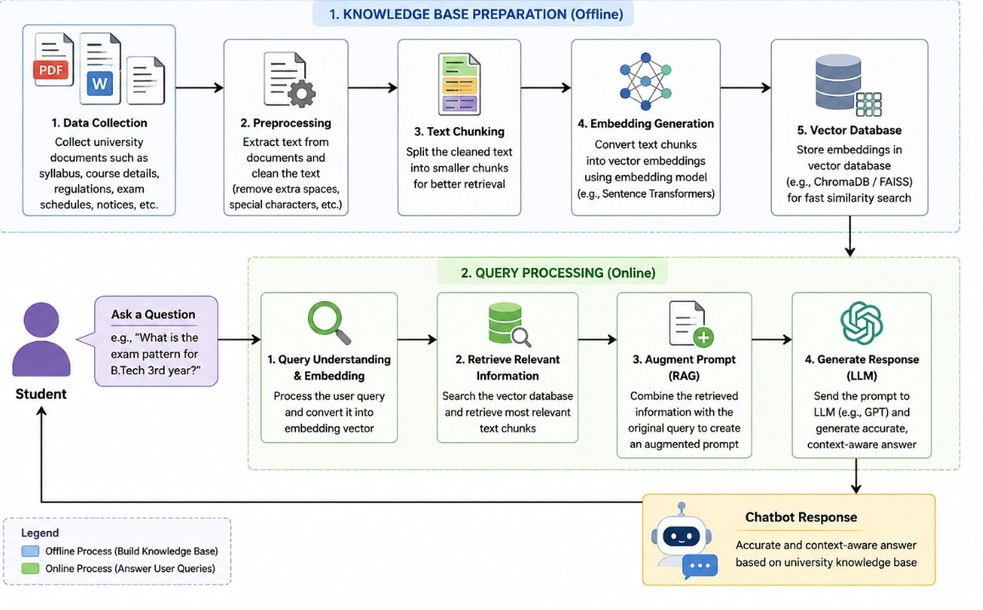
Proposed Method

Slide 7
Conclusion
The Retrieval-Augmented Generation (RAG) Chatbot for University Academic Assistance provides an effective solution for students to access university-related information such as syllabi, course details, examination schedules, academic regulations, and notices. By retrieving relevant information from the university knowledge base before generating a response, the system can provide more accurate, relevant, and context-aware answers.
Overall, the proposed system saves time for students, reduces the need to search through multiple documents and websites, and helps reduce the workload of administrative staff by answering frequently asked questions. The project improves the accessibility of academic information and provides a simple, efficient, and user-friendly platform for university academic assistance.

Slide 8
THANK YOU

